Slide 1
Core values & principles
A bit about how I’d like we cooperate

Slide 2
Core Values
The things I’d like to see both in your and my own actions.
Extreme honesty and open mindedness
Respect
As simple as that. Our team needs to be built on trust. There’s no place for lack of honesty in such a relationship. Even the worst truth is better than a lie. If things are bad, we need to know it. It allows us to work on mitigating them. Be authentic and honest.
We respect each other and what’s more important, we respect ourselves.
Empathy and being humane
Meritocracy
Before saying anything or taking something personal, try to put yourself in the other person’s shoes first. We are all human at the end of the day, mistakes happen.
Regardless of your seniority and any other factors, we follow meritocracy and learn to detach professional critique from personal one. Evidence-backed better solution is always preferable. Throw you ego away.
Ownership and responsibility
Take responsibility for your individual and companys overall goals. This also implies having initiative and taking pride in what you do. Own your tasks and your goals.

Slide 3
Being a leader means serving people
While technically I’m the Lead, it’s me who works for you, not the other way around
I’m here to make your life easier
‘Nuff said. While I’ll try to shape the general outlook and point the overall direction we will go in, the rest is on You.
Other than that I’m also here to eliminate obstacles from your way and make your life easier by enabling you to have hassle-free, efficient and meaningful work.
I’d like you to enjoy a great deal of ownership, independence and freedom.
Just remember that with freedom comes responsibility.
Taking this into consideration I want you to remember and internalize this: Do not hesitate to talk to me, ask questions, ask for help or whatever else you need. I’m here for you and I don’t bite.
Micromanagement is NOT an option.
I wrote an article about management/leadership that I’d like to share with you - Three levels of being a manager

Slide 4
External vs internal responsibility and ownership
In the end all you do reflects not only on yourself
Being a leader means being responsible
I want you to know that while inside the team we will all take responsibility for certain things and own them, it’s just internally.
Externally speaking, I’m the one responsible for the engineering efforts. Always remember that and worry not. Whatever you do, if things go bad the responsibility falls on me and I’ll be there to help. That’s what being a leader is all about. I’ll always have your back unless you deliberately act in a malicious way. That is off the limits.
Other than that I know that accidents happen despite best intentions. So please internalize the fact that I’d like us to have an environment where you guys feel safe and appreciated.
While we can have our differences inside the team/company, externally we always stand united no matter what.
So remember, your merits are yours to keep, but failures fall on me. Think of myself as a type of shield for the team, externally.
Bear in mind that it doesn’t mean lack of responsibility. It means that we solve our problems internally, not in front of the client or wider audience.
It also doesn’t mean that we cover our failures. Unless it was a malicious sabotage, failures are there to learn from, don’t be afraid to fail. It’s path of the process, unless it’s deliberate.

Slide 5
On ownership, independence and team-work
Why being independent doesn’t mean working with only yourself in mind.
Be locally independent and collaborative globally
While being independent person who takes ownership of their work is important, what’s more important is having the broad picture and the whole team and company in mind when planning and so on.
To clarify what I mean:
I’ll try to deliver the implementation of this view independently, but I do it because collaboratively Jason needs to have it so that he can integrate with the API.
I’ll independently do the deployment of this new service we create, but invite Jane for a screen sharing session because she mentioned that she’d like to learn how our deployment works.
When planning my work and the tasks I’m going to personally do, first I’ll consult the rest of the team regarding the priorities as maybe very small effort, on my side, with proper priorities, can unblock others.
I hope the examples above make it clear what I mean.
Be cooperative in your independent work.

Slide 6
Core Values
The things I’d like to see both in your and my own actions.
Enough of corporate coaching talk, to sum it up…
Always be honest
Take ownership
Follow meritocracy
Show empathy

Slide 7
When in doubt, always assume good intentions.
It’s easier to ask and clarify than solve a conflict or misunderstanding.

Slide 8
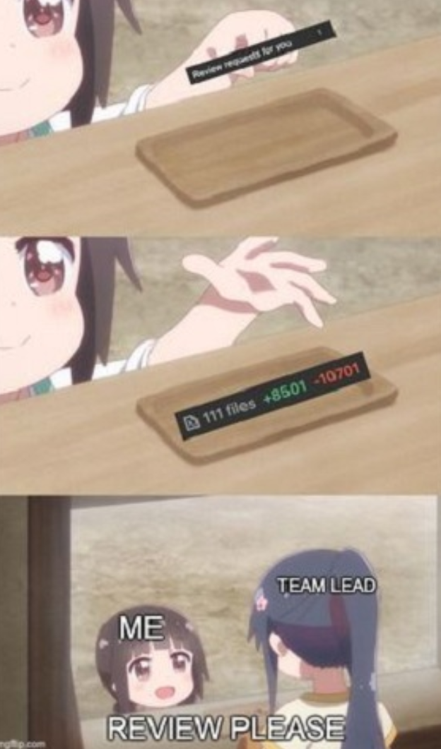
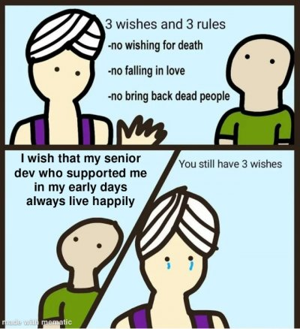
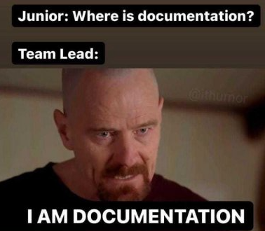
Serious self-righteous stuff aside,
here are some memes I enjoy to lighten up the mood

Slide 9
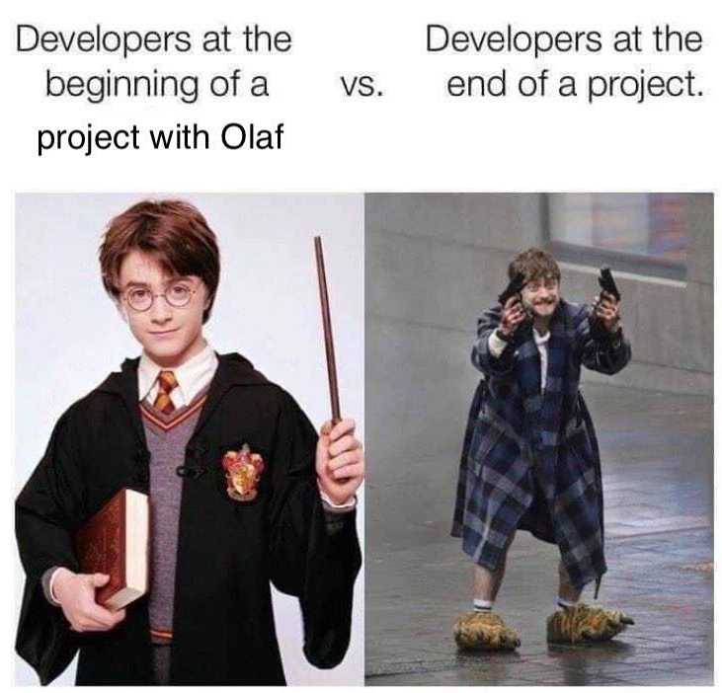
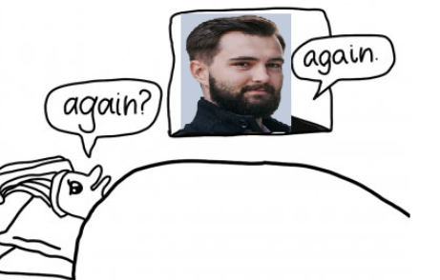
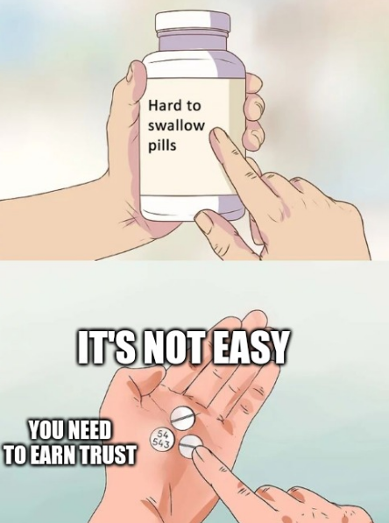
These were actually made by my former teammates. 10/10

Slide 10
Feedback? Questions?AMA.
Let’s get to know each other.

Slide 11
Thank you!

